Slide 1
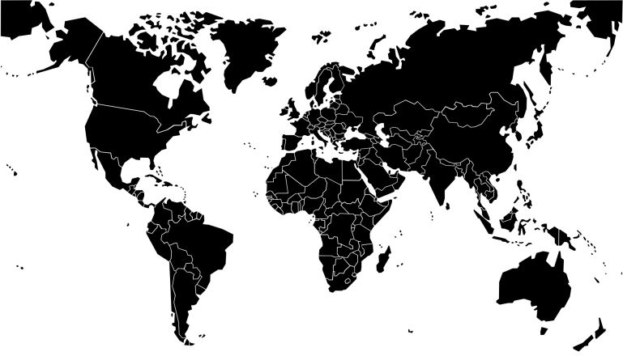
DimensionX
Discover productivity within
DimensionX photo
(e.g. https://www.apple.com/in/iphone-xr/ )
First ever in the history, the intelligent technology made one of the most powerful tool for the generation. Experience the amazing usability to find the incredible you.

Slide 2
The Power of DimensionX.
Watch the film
https://www.apple.com/in/iphone-xr/

Slide 3
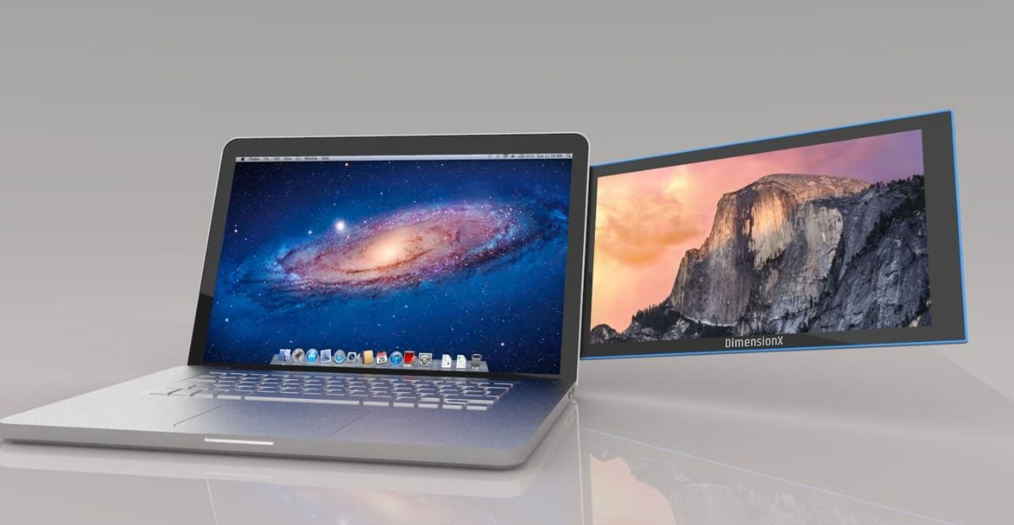
The Power of DimensionX.
DimensionX: The on-the-go dual screen laptop monitor. Completely portable dual screen laptop accessory for efficient multitasking and boosting the productivity. Allowing the usual laptop computer to compute more. Simply attach the DimensionX1.0 to any side of the laptop and you’re ready to draw the attention instantly.
Dimension
Available in three sizes 13.0”,14.1”,15.6”. 1080P
Compatible
Compatible with all operating systems
Light in weight
Available in 680gm-750 gm.
Easy to use
Backed with 3.0 USB cable to make it Plug and Play
180⁰ Rotation
Rotate at 180⁰ to enjoy the presentation mode.
Energy efficient
Does not require any power cable. Uses the Laptop’s energy to show through USB cable.

Slide 4
Licenses and Certifications
DimensionX: The on-the-go dual screen laptop monitor. Completely portable dual screen laptop accessory for efficient multitasking and boosting the productivity. Allowing the usual laptop computer to compute more. Simply attach the DimensionX1.0 to any side of the laptop and you’re ready to draw the attention instantly.
Dimension
Available in three sizes 13.0”,14.1”,15.6”. 1080P
Compatible
Compatible with all operating systems
Light in weight
Available in 680gm-750 gm.
Easy to use
Backed with 3.0 USB cable to make it Plug and Play
180⁰ Rotation
Rotate at 180⁰ to enjoy the presentation mode.
Energy efficient
Does not require any power cable. Uses the Laptop’s energy to show through USB cable.

Slide 5
-------DimensionX and You------
We’ll fix images of the use cases here in slider form. One slider one use case

Slide 6
We’ll write here testimonials

Slide 7
DimensionX in Media

Slide 8

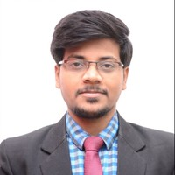
Team
Aditya Nath Jha, CEO. An engineer by chance, Entrepreneur by Choice. With his outstanding entrepreneurial experience, he handles the overall strategy and direction of the Company. In 2014 at 22 he founded a digital marketing company wherein to run the official tweets and social media campaigning for corporates and political leaders. He graduated in Computer Science from IGNOU. He dropped his Masters from IP university to peruse his entrepreneurial career. Since then he helped several companies and political leaders win the game.
Shanti Nath Jha, COO and CFO, makes the execution simpler. With his deep understanding on business advisory, finance, tax and other compliances, he brings the values in the process and connect the scattered dots. In his career, he worked with Consulting and Investment Banking firms creating strategies, doing business advisory, and performing diligences for Startups, Mid-sized companies. Before co-founding, DimensionX with Aditya, he was a part of Ernst and Young Business Valuation team in India. He is also acting as advisor for an Investment Banking firm and mentor for a Bengaluru based startup.

Slide 9
Our Culture
A good job isn’t always about the paycheck and insurance. Equivalent contribution to the lives of individual is equally important in the corporate culture. Considering the equal contribution in the lives of the employees we’ve developed a two way process.
to make the workplace to be fun and not miserably stressful given how many hours of their lives they will spend there.
planting the seed of continuous learning through regular training and learning sessions
Dimensus’s management’s commitment- “Valuing the resources are the prime responsibility of our organization-.” In order to meet the management’s commitment, we keep and will always keep our employees and our customers at first in the priority list. We are committed to build a culture of ownership in the cubicles and the foundation of faith in our customers.

Slide 10
Careers
Word from our leaders to new faces:
From the beginning till today, we have been thinking a lot about the product, innovation, quality, usefulness, customers, best services and what not. For us the hack to get all this in place is to have a great team who are empowered, well trained and then given a space to do things they know how to do. We are big fan of ideas driven people and this is our prime criteria at every level in the organization. We want people at DimensionX to be freaking passionate in the work they do, in sharing the ideas and making their contribution a never forgettable to us.
We Hire. We Train. We Work. You Lead
If you are wide in vision and detailed in execution, browse your fit place at DimensionX.

Slide 11
Footer section. Every time someone clicks, a new page will appear.
Contact us
Add
Phone
E-mail
Learn More
Your Name
Your Email
Register button
Follow DimensionX
Social Media Buttons

Slide 12
